Slide 1
Quote of the month:
“I got to be Patrol Leader within six weeks – I just shot to the top. That was the first time I realized I might have that (leadership) possibility.
Guess

Slide 2
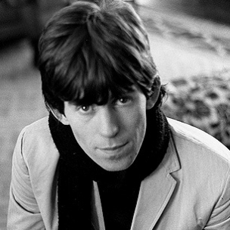
Quote of the month:
“Hey, I'm just going to duck and dive.” Once I had a bunch of guys together, it doesn't matter if it was the Scouts or a band, I could see my way clear to pull all their various talents together.”
Keith Richards
The Rolling Stones

Slide 4
COMMISSIONER Training Updates

Slide 5
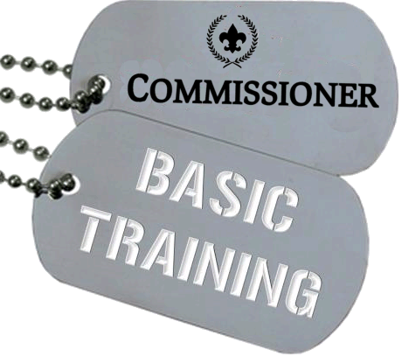
• April 12, 2014 – Sponsored by Area 3 8:30 AM (location TBD)
June 7, 2014 – Sponsored by Area 6 8:30 AM (location TBD)

Slide 6
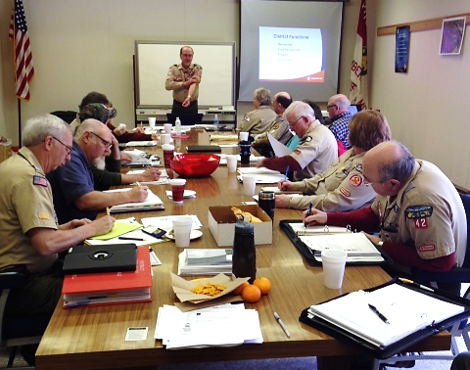
KUDOS!
• Bill Koller, Jack Boyde
Commissioner Basic Training
Dan Urban
Roundtable Staff Basic
Potomac District
Very Successful Commissioner Basic

Slide 7
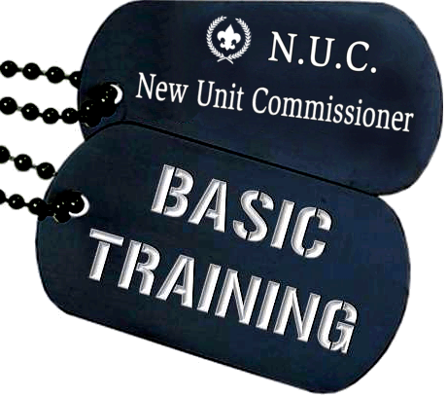
2 out of every 3 new units… FAIL!
Mark your Calendars!
April 12, 2014 – Council Led 8:30 AM (location TBD)

Slide 8
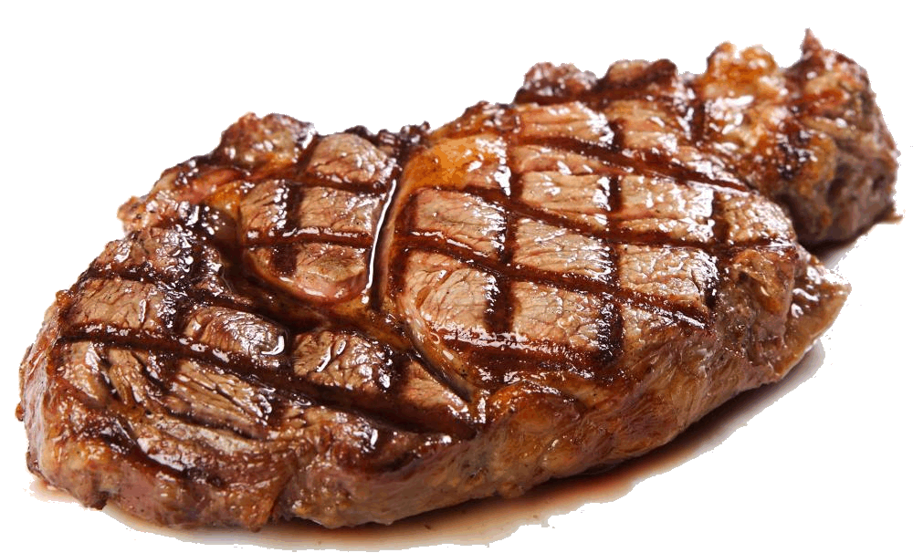
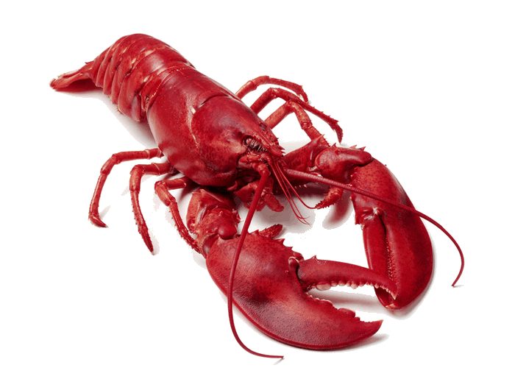
June 7 Camp Seph Mack
Commissioner Conference
Notes:
Don’t Miss This!

Slide 9
New!
Expanded!
University of Scouting
• March 15, 2014 @ IUP Includes Commissioner College
Notes:
March 15, 2014

Slide 10
Annual Service Plan
Feb
All: Charter Presentations
Mar
BS: Uniform Inspection
BS: Troop Open House
CS: Confirm cross overs!
Apr
Leadership Inventory
http://commissioner-bsa.org/service.html

Slide 11
New! Updated! Easier?
http://commissioner-bsa.org

Slide 12
Looking Ahead
Mining in Society
Launch February 24
Digital Technology
Replaces Computers – March 2014

Slide 13
Career Enhancement
How many DC’s (and ADC’s) have asked their USE to share their SMART goals?
(Their goals) are the basis for their annual review, promotion, compensation, and therefore, retention. The goals of the district committee and district commissioner team should be designed to ensure that the district Scouting professionals meet or exceed their “SMART goals,” and the district and assistant district commissioner should help them do this.
Council Commissioner Manual #522-015

Slide 14
COMMISSIONER General Updates

Slide 15
Council JTE Scorecard

Slide 16
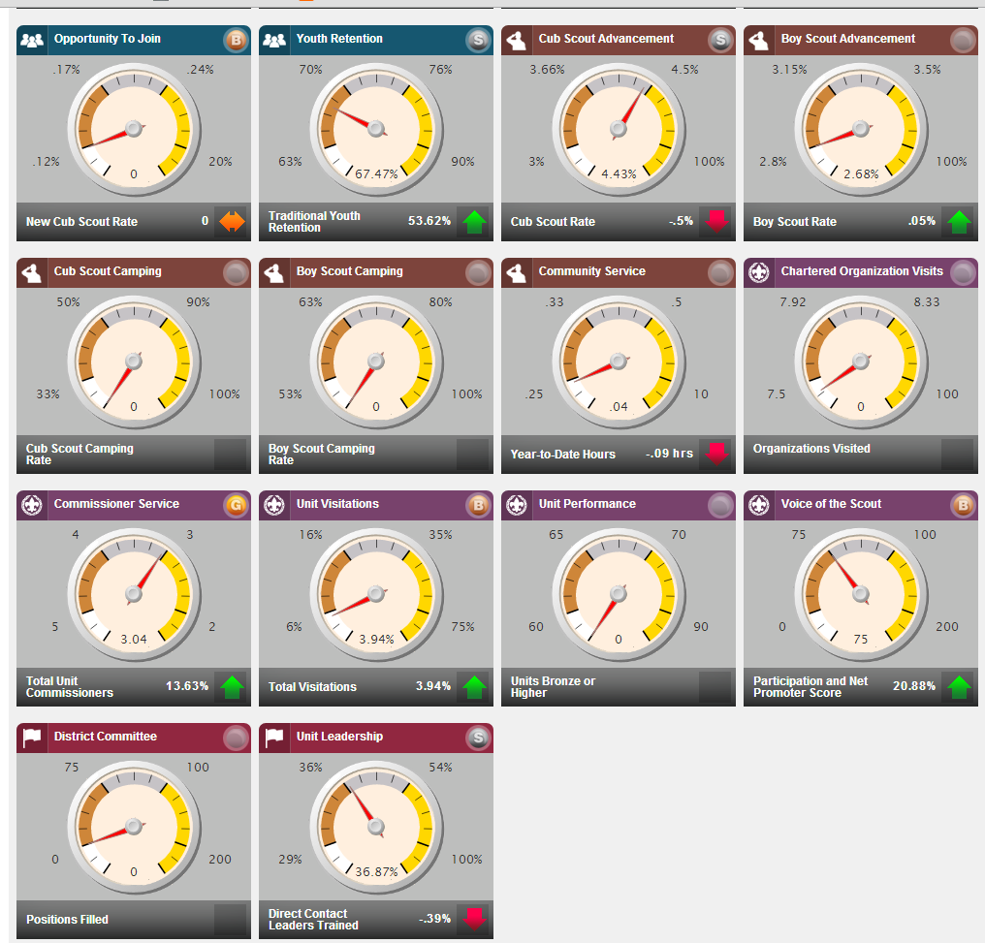
District JTE Scorecard

Slide 17
District JTE Scorecard

Slide 18
District JTE Scorecard
Some data is self-reporting:
Fundraising Dollars
Fundraising Manpower
Chartered Organization Visits
Unit Status
District Committee
Plus
Cub Scout Camping
Boy Scout Camping

Slide 19
District JTE Scorecard
Note:
It is recommended that data be entered for the most recent month by 5:00 PM Central Time on the 8th of each month in order to meet the deadline for the first monthly update of the dashboard.
Use Google Chrome or Mozilla Firefox

Slide 20
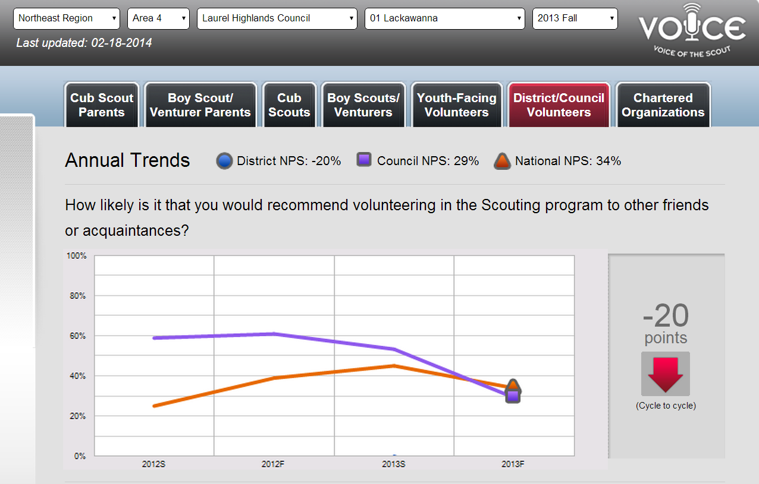
FYI
Fall 2013 Voice of Scout available
Spring 2014 Surveys coming soon
Interesting data…

Slide 21
#1 Priority
Potomac District +9
Frontier District +3
Suspects? Prospects?
Conestoga
Mon Valley
Steel City

Slide 22
MEMBERSHIP The Main Thing
National Numbers
Year End
Total Youth (160,748)
Total Units (3,810)
Total Leaders (36,786)

Slide 23
MEMBERSHIP The Main Thing
National Numbers
January
Total Youth (198,395)
Total Units (3,801)
Total Leaders (47,197)

Slide 24
MEMBERSHIP The Main Thing
LHC Numbers Year End
Total Youth +299
Total Units (48)
Total Leaders (246)

Slide 25
MEMBERSHIP The Main Thing
LHC Numbers January
Total Youth (830)
Total Units (68)
Total Leaders (428)

Slide 26
MEMBERSHIP The Main Thing
LHC Numbers January
Cub Scouts 11.4%
Boy Scouts 5.5%
Venturers 10.0%
Council/District Adults +55
Explorers +1,529
Notes:
Down Tiger Cubs (300)
Up Webelos (220)
Up Venturers (400)
Down Unit Adults (84)
Down Council/District Adults (63)

Slide 27
Recharter
100% Club
Mon Valley
Conestoga
Chief Logan
Council-Wide = 76%
89% excluding Scoutreach & Trailblazer

Slide 28
UVTS
Monthly unit visits are the single most critical issue to ensure the delivery of a quality program to every unit in our council.

Slide 29
2013 Summary
19% of units = JTE
41% of units = NO visits
Note: Scoutreach & Trailblazer are “unique” but still need Unit Service!

Slide 30
2014 January
Mon Valley = 52%
Council-wide = 14%
“Needs Improvement”

Slide 31
Roundtables
Scouting’s BEST opportunity to Train & Motivate Parents and Leaders.

Slide 32
Roundtables
Tracking Total Attendance
Compare Month-to-Month
Future Tracking: Unit Participation

Slide 33
Roundtables
Many Districts missing Roundtable Commissioners!
Four (4) RT Commissioners attended training

Slide 34
Unit Health
Lost 37 Units Last Year*
53 Units in Danger*
149 Need Help*
*Not counting Scoutreach & Trailblazer

Slide 35
Boys’ Life
Unit Commissioner
Serve at least two 100% BL Units
Roundtable Commissioner
Present and/or assist in presenting at least five BL roundtable promotion features.
Administrative Commissioners
Achieve 25% or more of the total units in service area as 100% BL –or–
Experience 10% growth in 100% BL 2013 vs 2012

Slide 36
Boys’ Life
Why?
Improve reading skills
Enhance rank advancement
Retention!

Slide 37
Commish Training
Data integrity issues
Report next month

